Slide 1
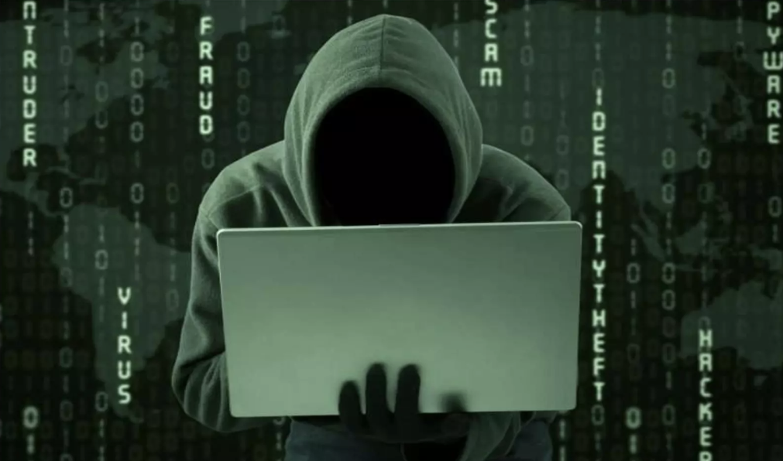
Module 3: Advanced Threat Intelligence
(Threat Analysis, Hunting & Proactive Defense)

Slide 2
Threat Hunting
Threat Hunting is a proactive search for hidden threats before alerts fire.
In this security analysts actively search for hidden attackers or malicious activities inside a system or network that traditional security tools may have missed.
Threat Hunting = Proactively searching for cyber threats that have bypassed security defenses.
Instead of waiting for an alert, analysts assume that an attacker may already be inside the network and start investigating.

Slide 3
Threat Hunting
Three very important concepts used in threat hunting
1. Indicators of Compromise (IoC)
2️. TTPs (Tactics, Techniques, Procedures)
3. Threat Intelligence
These three are the core foundation of modern threat hunting.

Slide 4
Threat Hunting
Common Hunting Questions
  Is there lateral movement?
  Are credentials abused?
  Is persistence present?
Most security systems like:
  Firewall
  Antivirus
  IDS/IPS
  SIEM
work in a reactive way (they alert after detecting known patterns).
But advanced attackers often avoid detection, so analysts manually investigate logs, network traffic, and system behavior.

Slide 5
Why Threat Hunting is Needed
Modern attacks use techniques like:
  Zero-day exploits
  Fileless malware
  Living-off-the-land attacks
  Advanced Persistent Threats (APT)
These attacks do not always trigger alerts. So, organizations perform threat hunting to detect them early.

Slide 6
Threat Hunting
Example: Imagine an attacker enters a network and installs a hidden backdoor.
Security tools may not detect it.
A threat hunter might notice:
A user logging in at 3 AM from another country
A system sending large encrypted traffic to an unknown IP
PowerShell commands running repeatedly
The hunter investigates these anomalies and finds the attacker.

Slide 7
Threat Hunting
Real-World Scenario
A company notices slightly increased DNS traffic.
Threat hunters investigate and discover:
Malware communicating with a command-and-control server
Data exfiltration happening slowly
Because of threat hunting, the attack is stopped before major damage occurs.

Slide 8
Threat Hunting Process
Typical steps:
1. Hypothesis Creation: The analyst creates a hypothesis.
Example: "An attacker may be using PowerShell for lateral movement."
2. Data Collection: Collect logs from:
Endpoints
Network traffic
Authentication logs
SIEM systems

Slide 9
Threat Hunting Process
Typical steps:
3. Investigation: Search for suspicious patterns:
Unusual login behavior
Strange processes
Suspicious command execution
4. Detection and Response
If malicious activity is found:
Isolate the machine
Remove malware
Patch vulnerabilities

Slide 10
Types of Threat Hunting
1. Hypothesis-Driven Hunting: Based on attacker behavior.
Example: Searching for credential dumping activity.
2. Indicator-Driven Hunting: Based on known Indicators of Compromise (IoCs) such as:
  Malicious IP
  Suspicious domain
  Malware hash
3. Anomaly-Driven Hunting: Looking for abnormal behavior using:
  Machine learning
  Behavior analytics

Slide 11
Threat Hunting
MITRE ATTACK in Threat Intelligence
Used to map adversary behavior
Identify detection gaps
Improve SOC coverage
Framework usage, not attack execution.

Slide 12
Tool Used in Threat Hunting
Common tools:
Splunk
Elastic Security
Wireshark
Sysmon
MITRE ATT&CK

Slide 13
Threat Hunting Vs Incident Response
Feature | Threat Hunting | Incident Response
Approach | Proactive | Reactive
Goal | Find hidden attackers | Respond to detected attack
Trigger | Analyst hypothesis | Security alert

Slide 14
Threat Intelligence -> Defense Mapping
Intelligence Type | Security Use
IoCs | Blocking
TTPs | Detection rules
Trends | Policy updates
Actor profiling | Risk prioritization

Slide 15
CTI Demonstration
These three tools are widely used in Cyber Threat Intelligence (CTI) and SOC environments:
Yara
openCTI
MISP

Slide 16
When Should Use
Scenario | Tool
Malware detection | YARA
IOC sharing | MISP
Threat intelligence analysis | OpenCTI
SOC automation | All three together

Slide 17
Thankyou

